Slide 1
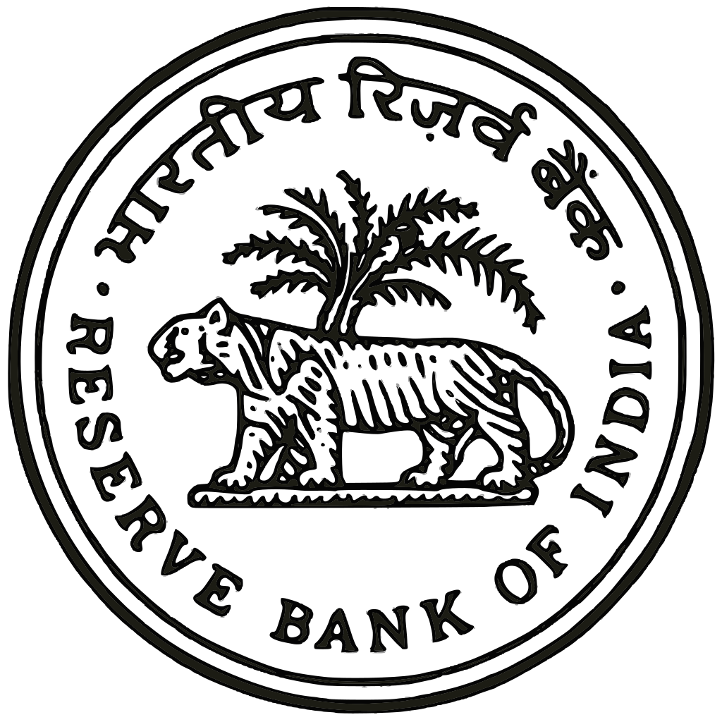
RBI AND ITS FUNCTIONS
Subject – Engineering Economics And Costing
Sub Code – CUTM-1012
GROUP-6

Slide 2

Introduction to RBI :
The Reserve Bank of India (RBI) is the central bank of India, established in 1935.
Initially headquartered in Kolkata, it moved to Mumbai in 1937.
It plays a crucial role in the Indian economy by regulating the monetary policy, managing currency, and overseeing the financial system.
Shaktikanta Das is the current and 25th governor of the Reserve Bank of India (RBI).

Slide 3
Organizational Structure of RBI
The organizational structure of the Reserve Bank of India (RBI) is designed to manage its wide range of functions effectively. It is headed by a Central Board of Directors and has multiple layers to ensure smooth governance and administration. Here’s an overview of the key elements in the RBI’s organizational structure :
Central Board of Directors
Governor and Deputy Governors
Regional offices across India

Slide 4
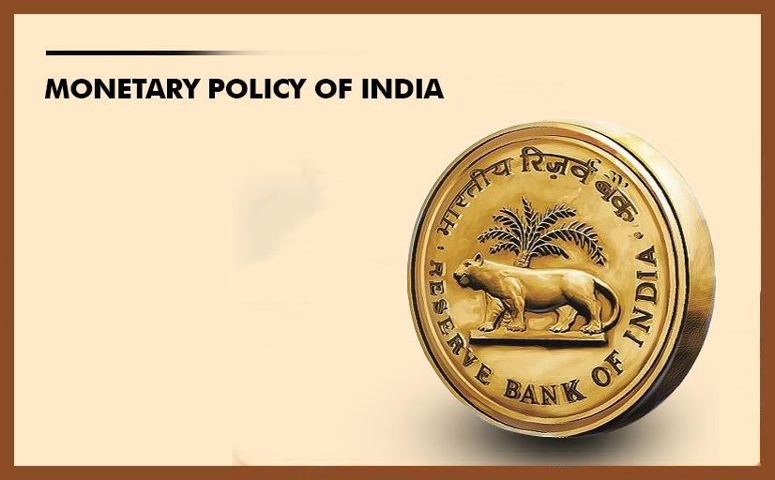
Monetary policy is a tool used by central banks to manage the money supply and achieve price stability, high employment, and other economic goals.
Central banks use monetary policy to influence interest rates, which in turn affect people's decisions to invest or consume.
These decisions impact economic growth, inflation, and employment.

Slide 5
Monetary Policy Tools
Repo Rate: The rate at which the RBI lends to banks. Lowering it stimulates borrowing; increasing it controls inflation.
Reverse Repo Rate: The rate at which banks lend to the RBI, used to absorb excess liquidity.
Cash Reserve Ratio (CRR): A percentage of deposits that banks must hold as reserves with the RBI.
Statutory Liquidity Ratio (SLR): The percentage of deposits that banks must invest in government securities.
Open Market Operations (OMOs): Buying/selling government securities to control liquidity.
Marginal Standing Facility (MSF): Allows banks to borrow overnight from the RBI during emergencies.

Slide 6
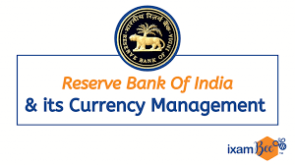
Currency Management
Sole Issuer of Currency: RBI issues all Indian currency notes; coins are minted by the Government of India.
Design and Security: Incorporates advanced security features to prevent counterfeiting.
Distribution: Manages printing, distribution, and withdrawal of currency through regional offices and currency chests.
Clean Note Policy: Promotes circulation of clean, high-quality notes and withdraws damaged ones.
Disposal: Destroys unfit and counterfeit currency notes.

Slide 7
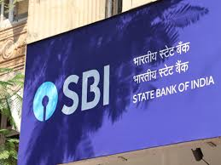
Regulation of Banks
Licensing: RBI grants licenses to new and foreign banks.
Capital Adequacy: Enforces Basel III norms for financial stability.
Reserve Requirements: Mandates CRR and SLR compliance.
Supervision: Conducts inspections using the CAMELS framework.
Lending: Sets rules for priority sector lending and risk management.
NPA Resolution: Provides frameworks like IBC to resolve stressed assets.
Customer Protection: Oversees fraud prevention and grievance redressal.

Slide 8

Management of Government Debt
Banker to Government: Manages accounts and finances of central and state governments.
Borrowing Programs: Executes borrowing via bonds and treasury bills.
Debt Management: Ensures timely repayment and liquidity control.
Auctioning Securities: Issues government securities through auctions.

Slide 9

Foreign Exchange Management
Managing foreign exchange transactions to minimize losses and maximize gains
Key Objectives:
  Minimize losses
  Maximize gains
  Ensure compliance

Slide 10
Developmental Role
The Reserve Bank of India (RBI) plays a crucial role in promoting economic development through various initiatives.
Key areas:
  Financial Inclusion
  Microfinance
  Infrastructure Development
  Small Industries Development
  Rural Development

Slide 11

Regulation of NBFCS
The Reserve Bank of India (RBI) regulates Non-Banking Financial Companies (NBFCs) to ensure their stability and soundness.
Key aspects:
  Licensing and Registration
  Capital Adequacy
  Asset Classification and Provisioning
  Lending and Investment
  Risk Management
  Supervision and Inspection

Slide 12

RBI and Inflation Targeting
The Reserve Bank of India (RBI) uses inflation targeting to maintain price stability.
Key aspects:
  Inflation Target: 4%
  Monetary Policy Committee (MPC)
  Repo Rate and Reverse Repo Rate
  Inflation Forecasting
  Price Stability

Slide 13

Digital Payment Systems
The Reserve Bank of India (RBI) promotes digital payment systems to increase financial inclusion and efficiency.
Key initiatives:
  Unified Payments Interface (UPI)
  National Electronic Fund Transfer (NEFT)
  Real-Time Gross Settlement (RTGS)
  Digital Wallets
  Point of Sale (PoS) Terminals

Slide 14

Risk Management
Risk Management by RBI
The Reserve Bank of India (RBI) implements risk management strategies to ensure financial stability and safety.
Key areas:
  Credit Risk
  Market Risk
  Operational Risk
  Liquidity Risk
  Cyber Risk
  Compliance Risk

Slide 15
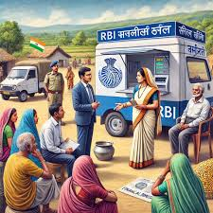
Financial Inclusion Initiatives
The Reserve Bank of India (RBI) promotes financial inclusion through various initiatives.
Key initiatives:
  Pradhan Mantri Jan-Dhan Yojana (PMJDY)
  Microfinance
  Rural Banking
  Digital Payments
  Financial Literacy and Awareness

Slide 16
Research and Development
The Reserve Bank of India (RBI) invests in research and development to enhance its capabilities and services.
Key areas:
  Monetary Policy Research
  Financial Stability Research
  Payment and Settlement Systems Research
  Financial Inclusion Research
  Cyber Security Research

Slide 17

Recent Innovations
The Reserve Bank of India (RBI) has introduced several innovative initiatives to enhance its services and promote digital payments.
Key innovations:
  Unified Payments Interface (UPI)
  National Payments Corporation of India (NPCI)
  Aadhaar-Enabled Payment Systems
  Digital Lending Platforms
  Central Bank Digital Currency (CBDC)

Slide 18
Key Achievements
The Reserve Bank of India (RBI) has achieved significant milestones in promoting economic growth and stability.
Key achievements:
  Lowest Inflation Rate in 5 years (2016-2021)
  Highest GDP Growth Rate in 11 years (2016-2017)
  Increased Foreign Exchange Reserves
  Improved Financial Inclusion
  Enhanced Digital Payments Infrastructure

Slide 19

Conclusion
The Reserve Bank of India (RBI) plays a vital role in promoting economic growth, stability, and development.
Key takeaways:
  Monetary Policy Framework
  Financial Inclusion Initiatives
  Risk Management
  Digital Payments Infrastructure
  Inflation Targeting
RBI: A Pillar of India's Economic Growth

Slide 20

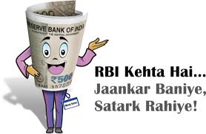

Slide 21

Presented By Group-6
Chandrabhanu das
Subham Singh
Rudra Narayan Behera
Prithaviraj Devakar
Kriti Prabhakar
Priyabrata Biswal
h

